Slide 1
Application Agnostic Data Leakage Detection in Managed Environments λDataAccess2Vec
Perimeterless: WP6 - PoC algorithm for detecting data leakage
Shachar Frank & Eitan Klevansky

Slide 2
Agenda
Motivation & Goal
Method
Feature Engineering
Evaluation and Results
Contribution & Insights

Slide 3
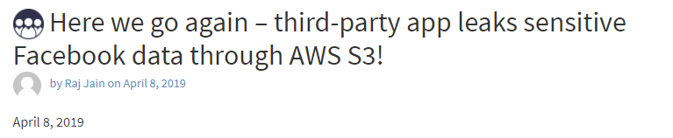
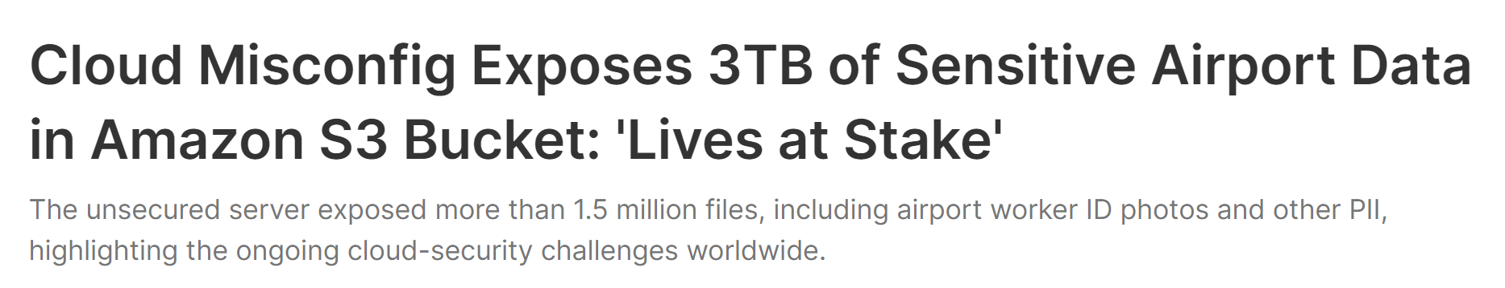
Motivation
Date | Description | Notes
Oct 2023 | India’s national logistics portal exposed sensitive personal data, trade records | Exposed sensitive personal data and various state and private trade records.
Aug 2022 | Cloud Misconfig Exposes 3TB of Sensitive Airport Data in Amazon S3 Bucket: 'Lives at Stake' | That is sure a lot of data on S3
July 2022 | McGraw Hill's S3 buckets exposed 100,000 students' grades and personal info | 22 TB of data and over 117 million files
Aug2020 | S3 bucket mess up exposed 182GB of senior US, Canada citizens data | The misconfigured S3 bucket was owned by SeniorAdvisor, a consumer ratings and reviews website.
July2020 | Twilio: Someone broke into our unsecured AWS S3 silo, added 'non-malicious' code to our JavaScript SDK | Attackers tried to update the javascript library hosted on the s3 buckets so this can be picked up by other clients
Data leakage attacks are extremely difficult to detect, as the attacker may have different exfiltration profiles.
In the previous phase of the project, BGU designed and developed a PoC for data leakage detection in the cloud environment.
During this phase, the PoC is adapted to be application agnostic.
Git repository tracking known AWS S3 leaks
https://securityboulevard.com/2019/04/here-we-go-again-third-party-app-leaks-sensitive-facebook-data-through-aws-s3/
Link
Notes:
The discovery of application flows can help security analysts and incident response handlers to gain contextual information on the alerts they handle, and thus reduce their time and effort in decision making.

Slide 4
Goal
Develop a generic AI-based data leakage detection method
Adaptable for multiple serverless applications using standard AWS logs
Minimal model training requirements
Capable of utilizing log data aggregated within the SIEM system for an effective POC
Notes:
The management and security of such applications are complicated due to many functions and resources, a lack of visibility and context, and the fact that the analysts are unfamiliar with the application structure.
Analyzing and handling security incidents becomes very complicated and time-consuming.
The inability to understand the application logic from the point of view of an operator who is not aware of the application design due to the complex interaction among many serverless elements as well as the rapid code changes to serverless applications which are difficult to track from the documentation.

Slide 5
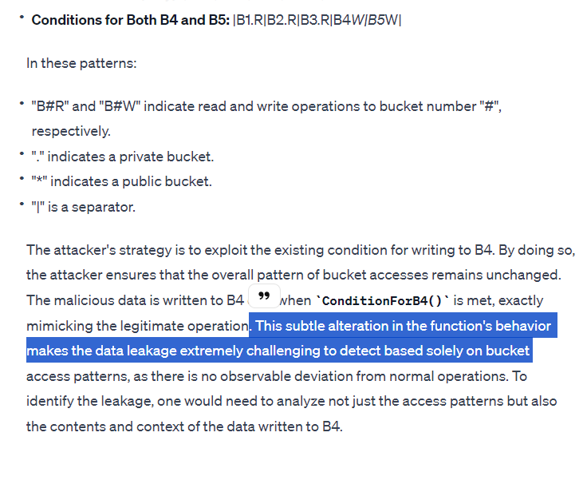
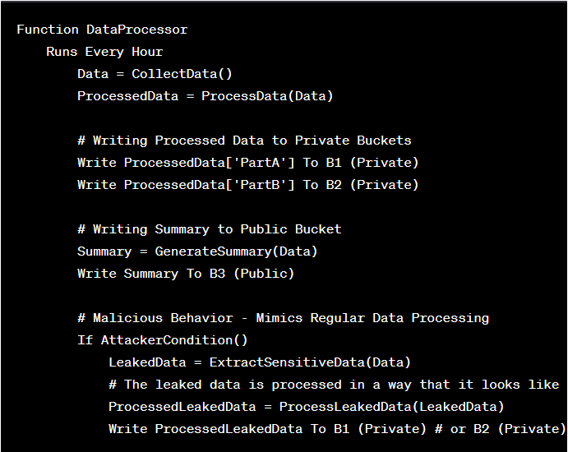
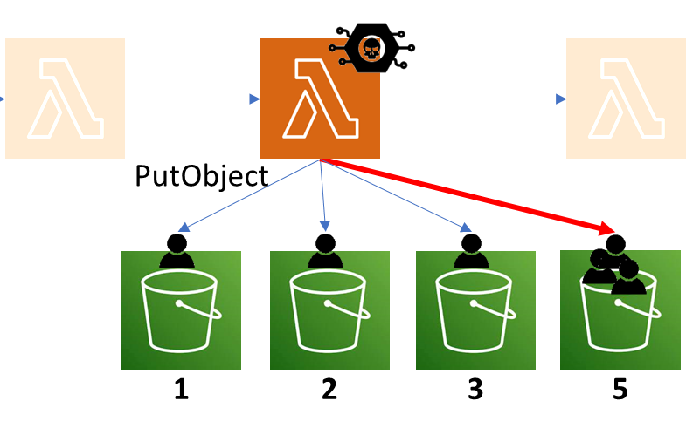

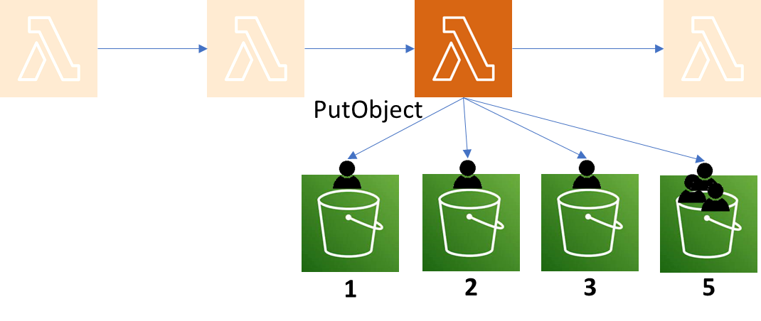
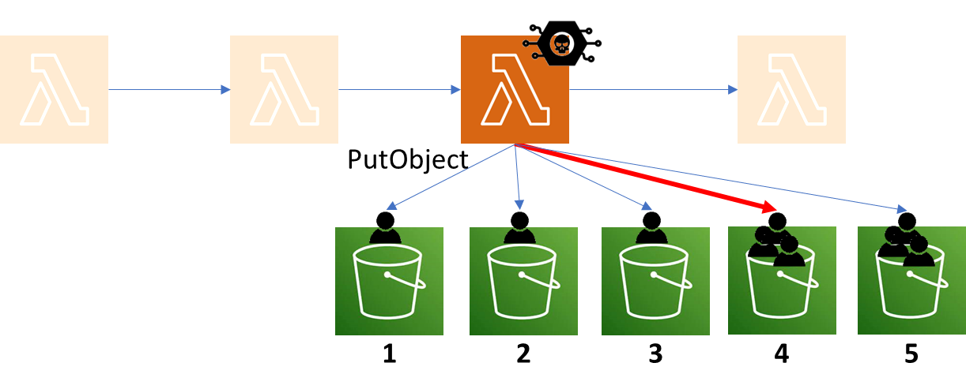

Log
λ : B1 Read, B2 Read, B3 Read
λ : B1 Write, B5 Write*
λ : B1 Read, B2 Read, B3 Read, B4 Write*
Actual Log
Order of events
Different Attack
No Color
λ : B1 Read
λ : B2 Read
λ : B3 Read
λ : B1 Read
λ : B5 Write*
λ : B1 Read
λ : B2 Read
λ : B3 Read
λ : B4 Write*
λ : B2 Read
λ : B1 Read
λ : B3 Read
λ : B5 Write*
λ : B1 Read
λ : B1 Read
λ : B2 Read
λ : B4 Write*
λ : B3 Read
λ : B2 Read
λ : B1 Read
λ : B3 Read
λ : B5 Write*
λ : B1 Read
λ : B1 Read
λ : B2 Read
λ : B5 Write*
λ : B5 Write*
λ : B3 Read
λ : B2 Read
λ : B1 Read
λ : B3 Read
λ : B5 Write*
λ : B1 Read
λ : B1 Read
λ : B2 Read
λ : B5 Write*
λ : B5 Write*
λ : B3 Read
λ : B2 Read
λ : B1 Read
λ : B3 Read
λ : B5 Write*
λ : B1 Read
λ : B1 Read
λ : B2 Read
λ : B5 Write*
λ : B5 Write*
λ : B3 Read
If Rule1
Write X To Bucket1:Private
Write Y To Bucket2:Private
Write Z To Bucket3:Private
Else
Write X To Bucket1:Private
Write Y To Bucket5:Public
If Rule1
Write X To Bucket1:Private
Write Y To Bucket2:Private
Write Z To Bucket3:Private
if the Time is around Noon
Write (X, Y, Z) To Bucket4:Public
Else
Write X To Bucket1:Private
Write Y To Bucket5:Public
(+Concurrency)
* Public Bucket

Slide 6


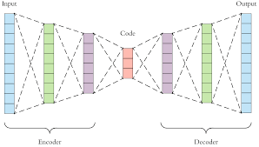
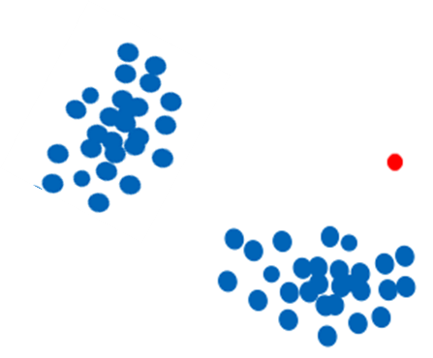
λDataAccess2Vec : Method
Data Collection
Preprocessing & Feature Extraction
Autoencoder (pre-trained Benign)
LOF Identify Anomalous Write Behavior (Per λ)
Time Window, λ Func.
Features
TW₁
λ ₁
F₁
…
F_{N}
TW₁
λ ₂
F₁
F_{N}
TW₁
λ _{M}
F₁
F_{N}
…
Anomalous
AWS CloudTrail
…
F_{N}
TW_{t}
λ ₁
F₁
TW_{t}
λ ₂
F₁
F_{N}
TW_{t}
λ _{M}
F₁
F_{N}
Contextualized embeddings of λ Write Behaviors
Using unsupervised anomaly detection (Clustering, LOF) to identify anomalous write behaviors of a λ function

Slide 7
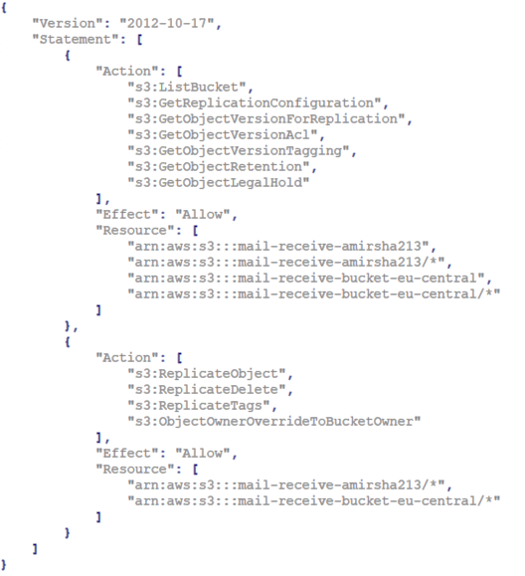




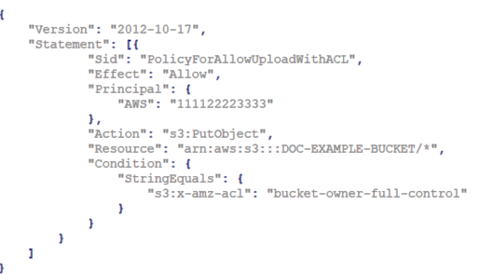
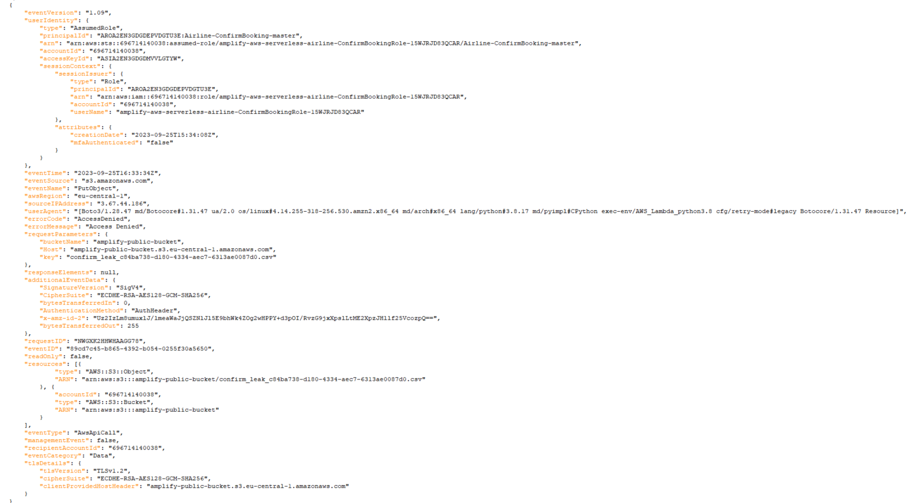
Conceptual λDataAccess Log
Role Access Policy (Example)
Allowed Operation(s)
Assumed Role (λ Policy)
F₁
F₂
F₉
F₂
F₃
F₁
F₉
Function Access Permission toward Resource(s)
Serverless Function
Data Access
Bucket
B₂
B₁
B₇
B₃
B₄
B₁
B₁
Log
…
Resource Permission Access (Bucket White/Black-list)
Time-Line
10:13
10:20
10:43
10:56
11:06
11:23
11:45
Time-Based (1H)
CloudTrail API Call Log
Invocation-Based (F9-F9)
Private Access
Public Access
Count-Based (5 operations)
Event Type : AwsApiCall
Event Category: Data
Event Name: PutObject
Read Only : True
Data Access Aggregation Window (Types)

Slide 8
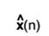
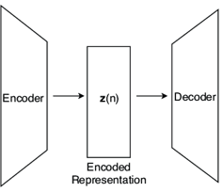
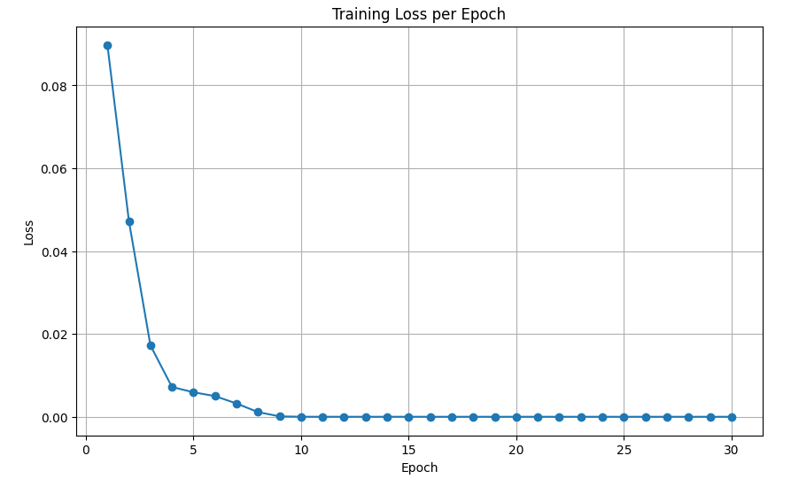
λDataAccess2Vec : Method Autoencoder
TW₁,λ Func. ₁
TW₁,λ Func. ₂
TW_{N}, λ Func. _{M}
Batch
Input Time Windows Write Access Features
Contextualized embeddings of λ Write Behaviors
Reconstructed Time Windows Write Access Features
Time Windows

Slide 9


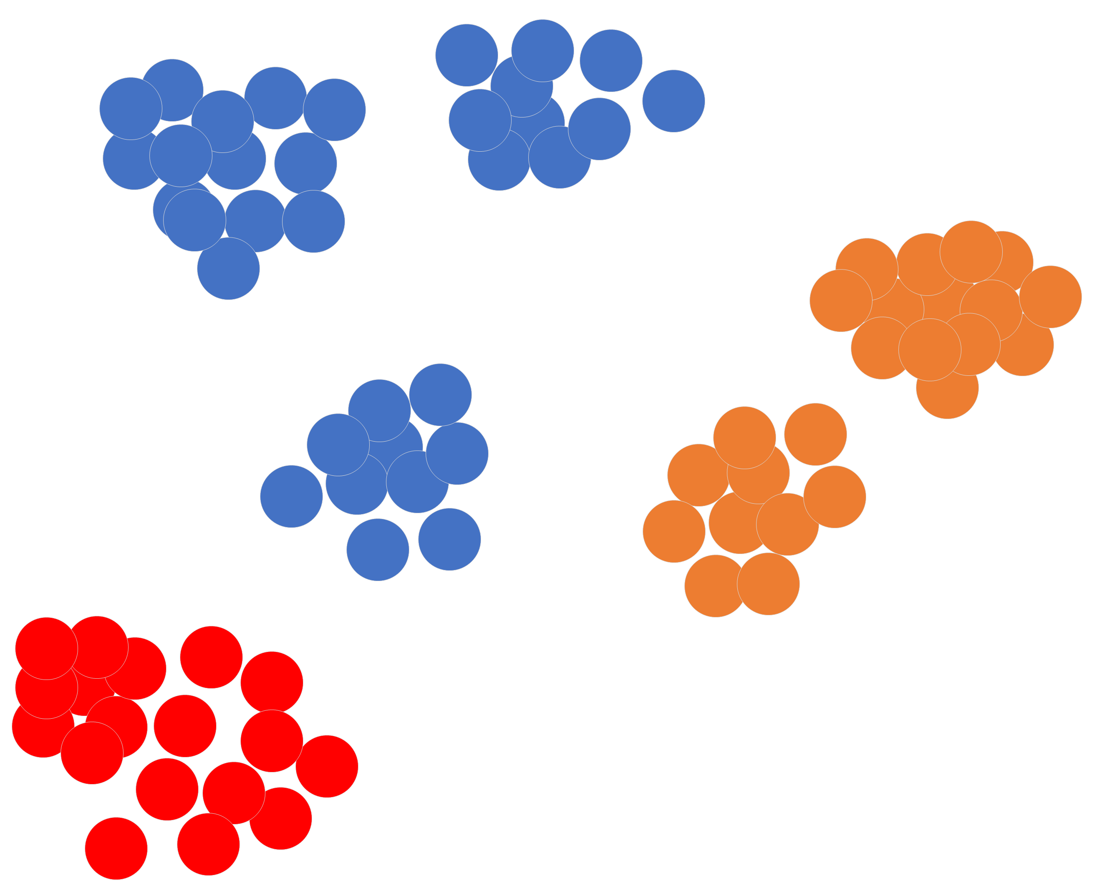

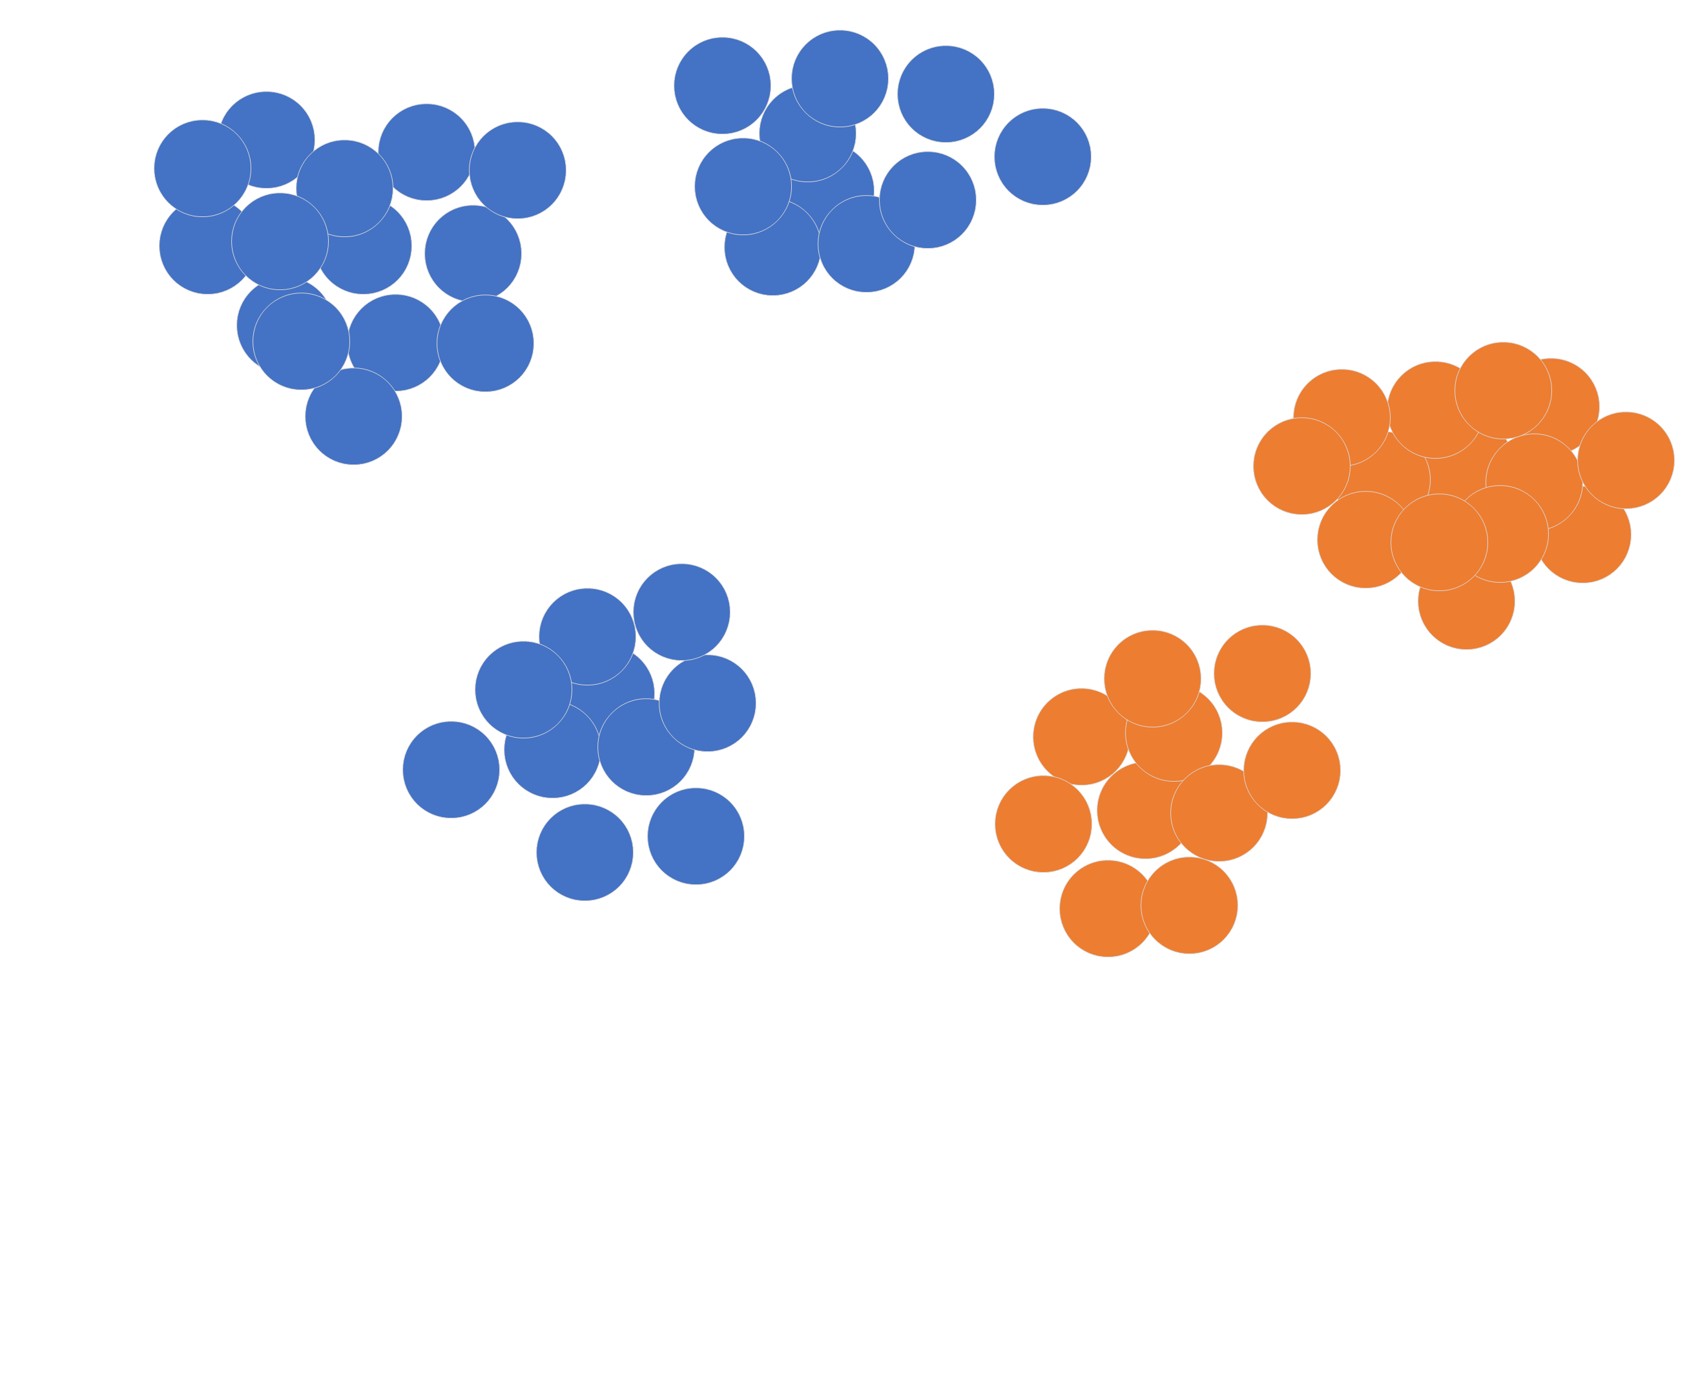
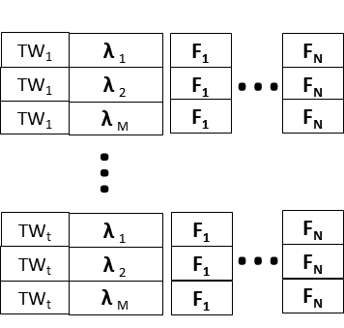

λDataAccess : Detection in 3 steps
Contextualized embeddings of multi-function λ public write behaviors
Anomalous
LOF : comparing the local density of a point with the densities of its neighbors. The new point has a much lower density than its neighbors.
The new λ behavior is compared with past behaviors of the same function
Feature Extraction
Data Access Log
Benign
Benign
Unknown
Time-Line
t1….t2….t3....
1
2
3
Autoencoder Pre-Training
Profiling Behaviors
Detection
Feature Extraction
Feature Extraction

Slide 10
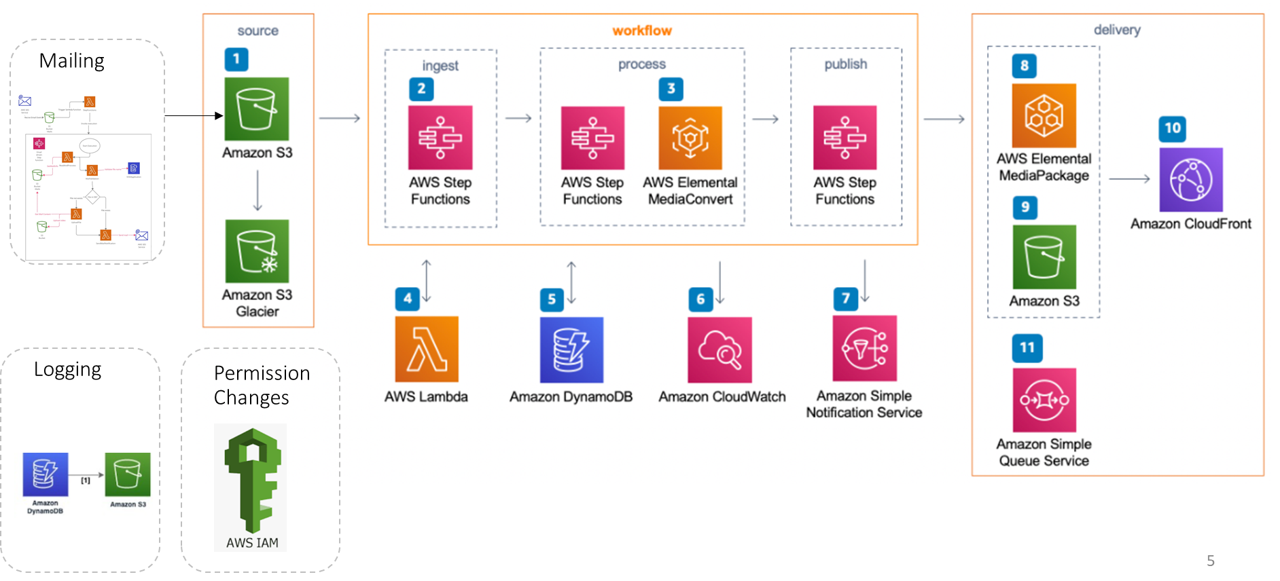
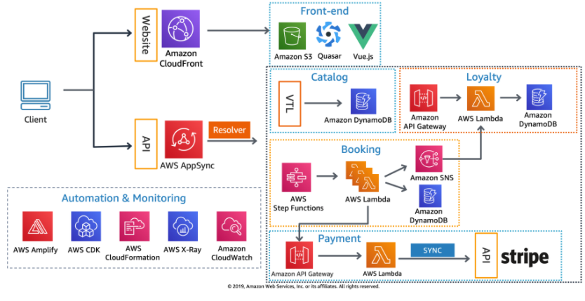
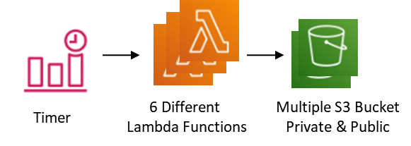
Testbed : Architecture
1) SERVERLESS AIRLINE BOOKING SYSTEM
2) VIDEO ON DEMAND (VOD) APPLICATION
3) SIMPLE TIMER-BASED (SYNTHETIC) UNIFORM BEHAVIOR

Slide 11
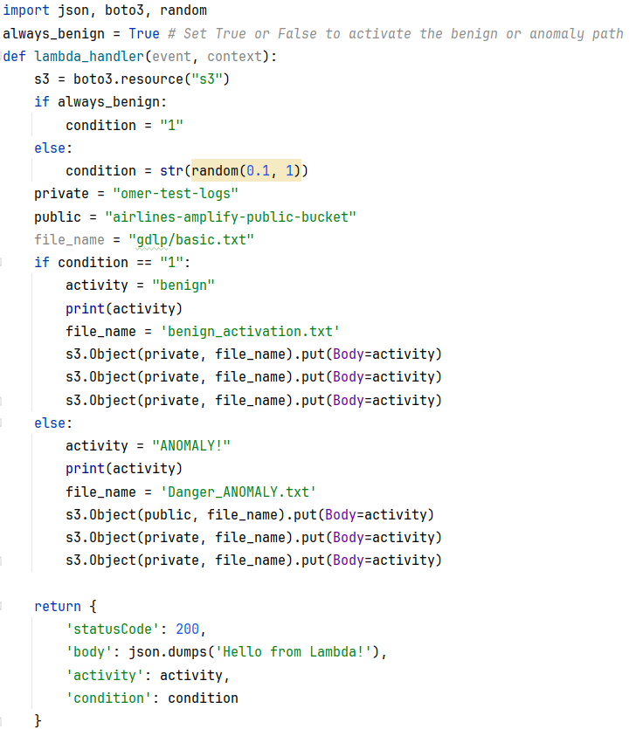
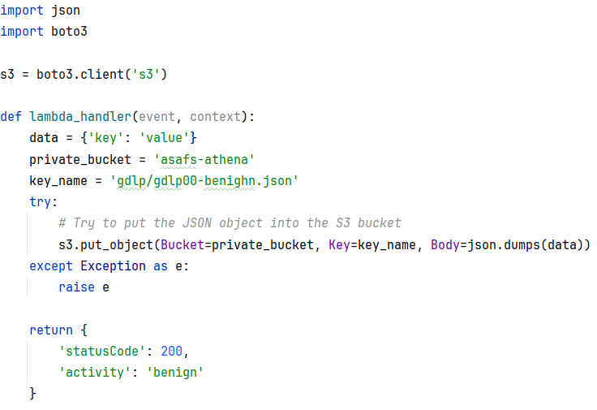
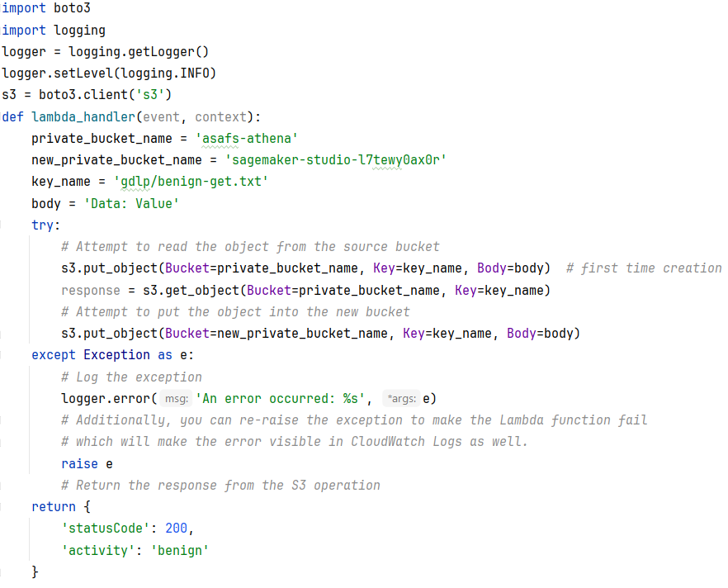
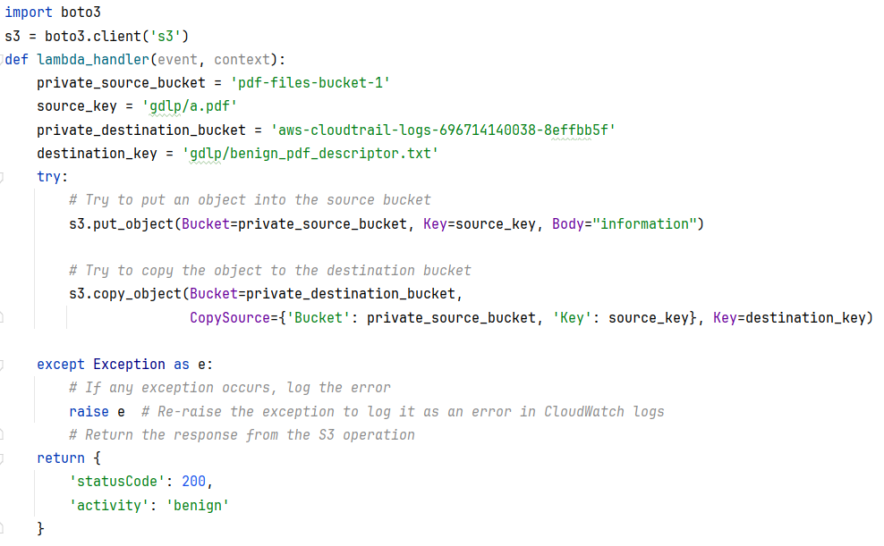
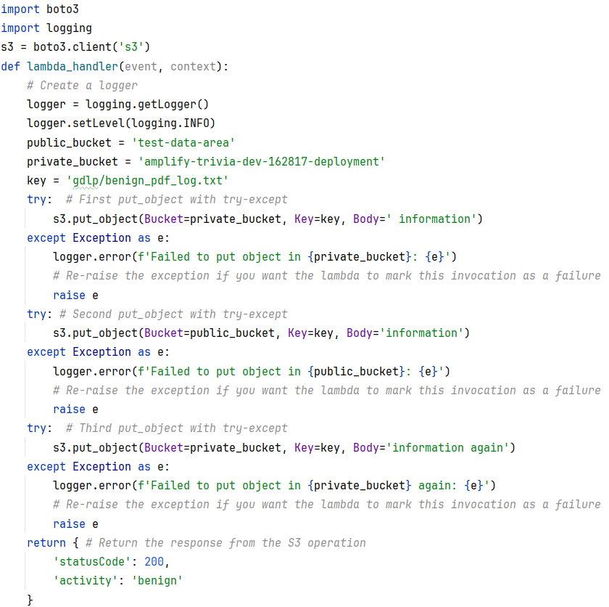
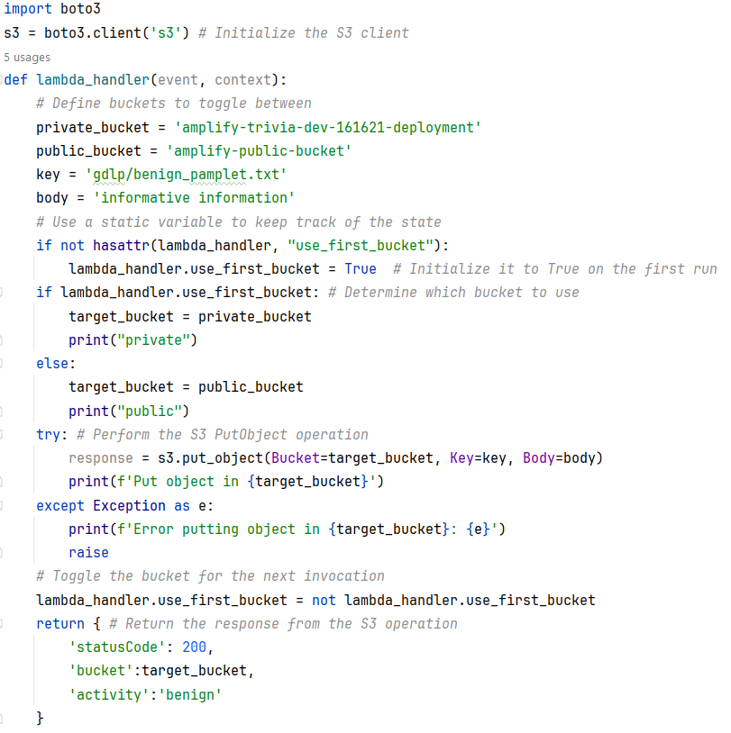
Testbed : Simple Experiment Lambdas
6 Lambda Functions, Anomaly on top
Notes:
The management and security of such applications are complicated due to many functions and resources, a lack of visibility and context, and the fact that the analysts are unfamiliar with the application structure.
Analyzing and handling security incidents becomes very complicated and time-consuming.
The inability to understand the application logic from the point of view of an operator who is not aware of the application design due to the complex interaction among many serverless elements as well as the rapid code changes to serverless applications which are difficult to track from the documentation.

Slide 12
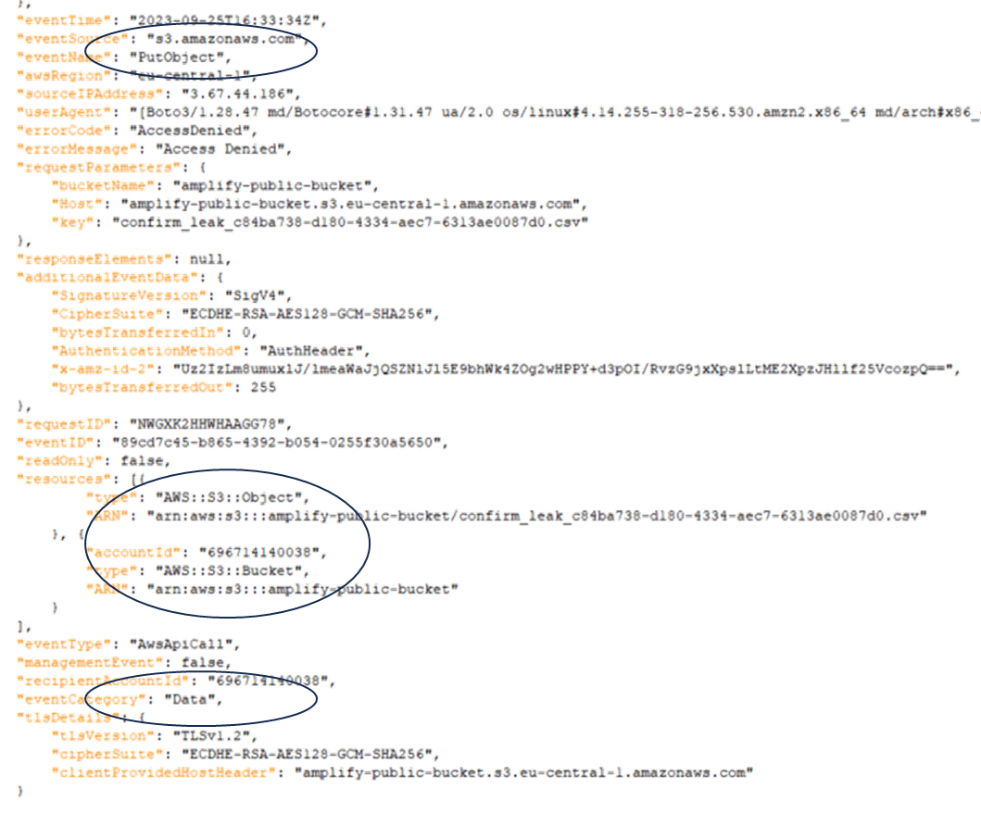
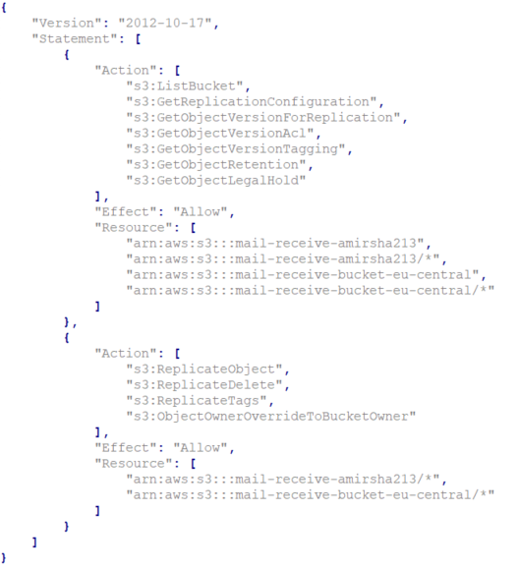
Data : CloudTrail Data Event Category : JSON

Slide 13
Feature Engineering : RAW Data Modeling
Time - Event time (DateTime)
Read Only –Read permissions indication (Boolean)
Operation - Data access operation, i.e.: PutObject, GetObject, etc. (string) from defined set.
Source - AWS Lambda (role name), the source of the Operation, string.
Target - Operation target; in case of S3 it is a bucket name, string.
Bucket Access - indicate whether the bucket is “public” or “private”, based on configuration or collected from resource permission change log (over time). It is external and is not included in the API call log.
Key - used for tagging the anomalous behavior, extracted from the resource parameters in the data API log.
Notes:
The management and security of such applications are complicated due to many functions and resources, a lack of visibility and context, and the fact that the analysts are unfamiliar with the application structure.
Analyzing and handling security incidents becomes very complicated and time-consuming.
The inability to understand the application logic from the point of view of an operator who is not aware of the application design due to the complex interaction among many serverless elements as well as the rapid code changes to serverless applications which are difficult to track from the documentation.

Slide 14
Feature Engineering : Calculated
Features are per time window & and Lambda function
Write Access Percentage - Measures how often a Lambda function performs write operations as opposed to read-only operations. A high percentage may indicate unusual data writing activity.
Bucket Access Indicators (Private and Public) - Indicate the function's access to private and public S3 buckets.
Private/Public Access Ratio - Compares the frequency of accessing private buckets to public ones. An unexpected increase in public bucket access could signal potential security concerns.
Public Access Percentage - Indicates the proportion of a function's operations involving public buckets. An increase might raise concerns about data exposure.
Bucket Access Count (Private and Public) - Tracks the frequency of a function's access to private and public S3 buckets. A shift in this pattern can suggest changes in data handling practices.
Notes:
The management and security of such applications are complicated due to many functions and resources, a lack of visibility and context, and the fact that the analysts are unfamiliar with the application structure.
Analyzing and handling security incidents becomes very complicated and time-consuming.
The inability to understand the application logic from the point of view of an operator who is not aware of the application design due to the complex interaction among many serverless elements as well as the rapid code changes to serverless applications which are difficult to track from the documentation.

Slide 15
Testbed : Datasets & Stats
Anomalies | # Anomalies | Duration | Time Windows | Data Events | Dataset
% (TW) | Count
~3.4% | 5 | ~2.5H | 148 | 2099 | SIMPLE
~55% | 55 | ~1.5H | 99 | 3638 | AIRLINE
~20% | 99 | ~8H | 480 | 503,273 | VOD

Slide 16
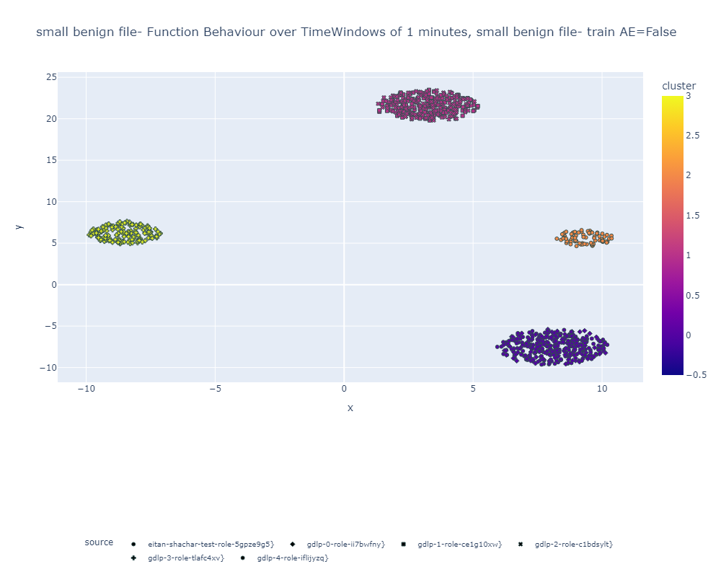
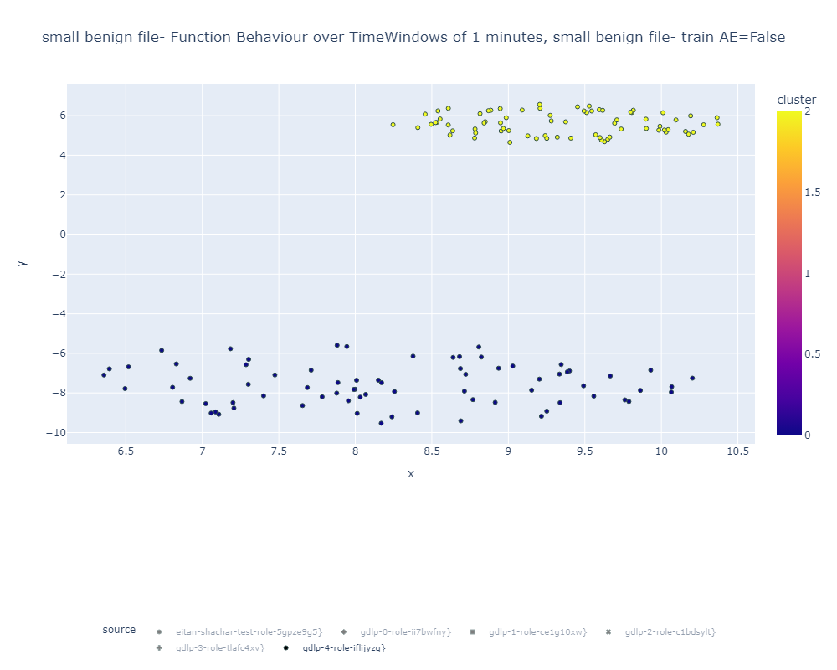
Evaluation and Results – Simple Dataset
Experiment:
6 Functions (1 with dormant anomaly)
Timer-based (Uniform)
4 Benign clusters (KMeans)
Overlapping function behaviors
Function with normal alternating writing behavior - Reflected by the feature
Notes:
The management and security of such applications are complicated due to many functions and resources, a lack of visibility and context, and the fact that the analysts are unfamiliar with the application structure.
Analyzing and handling security incidents becomes very complicated and time-consuming.
The inability to understand the application logic from the point of view of an operator who is not aware of the application design due to the complex interaction among many serverless elements as well as the rapid code changes to serverless applications which are difficult to track from the documentation.

Slide 17
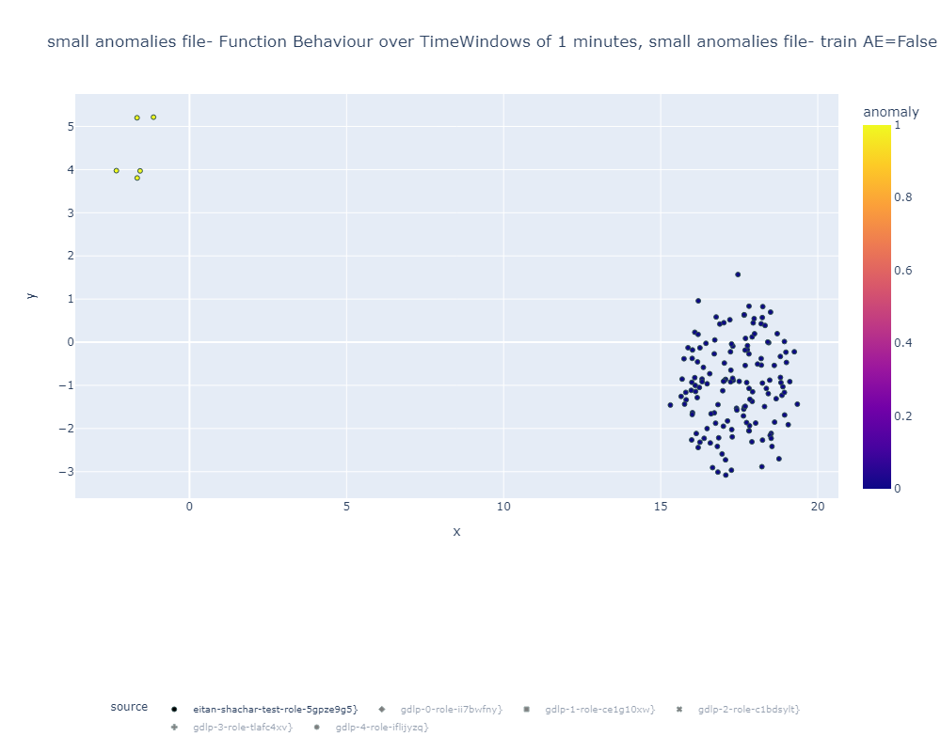
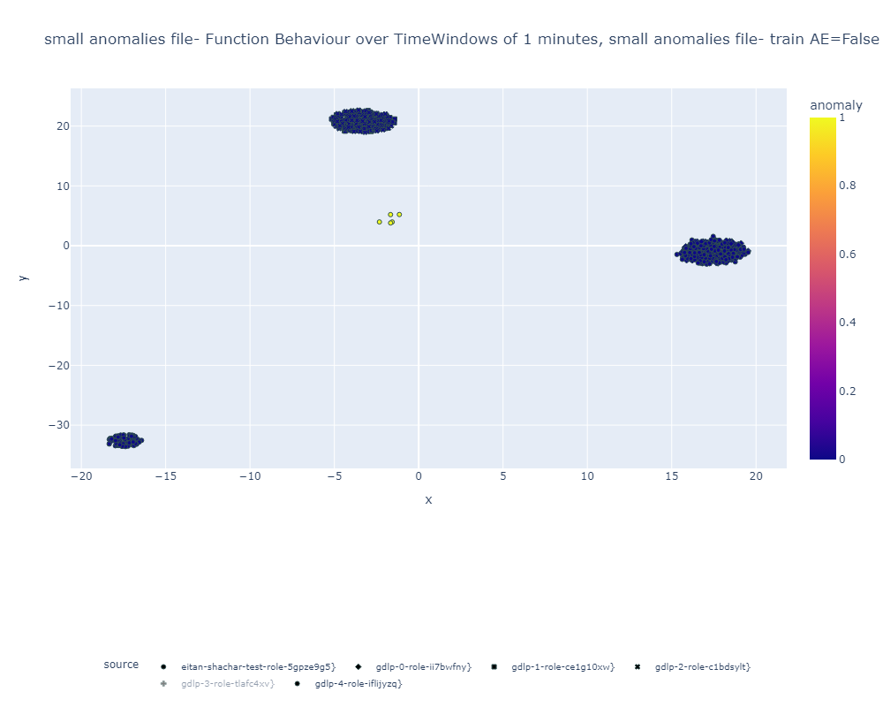
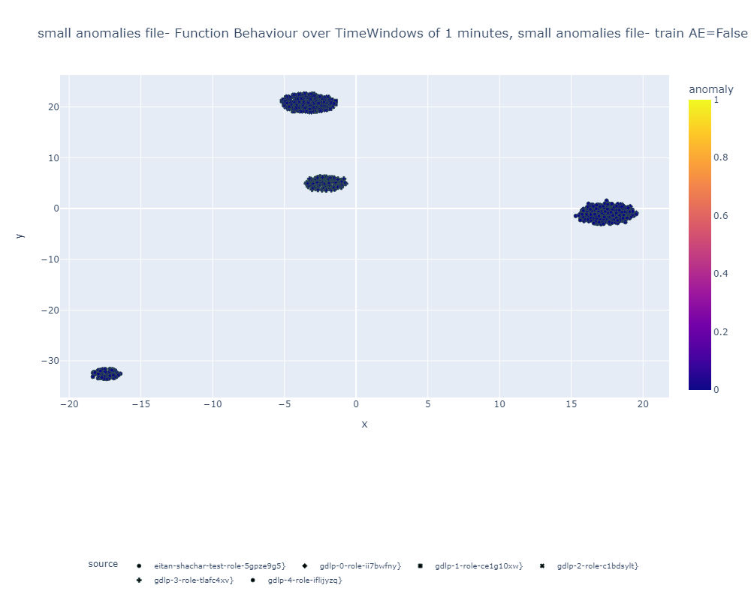
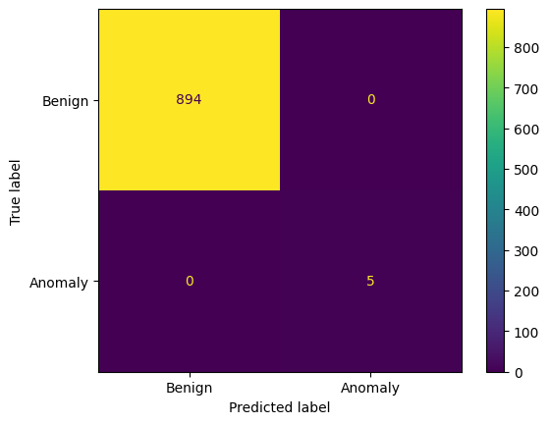
Evaluation and Results – Simple Dataset
Experiment:
6 Functions (1 with active anomaly)
Timer-based (Uniform)
5 clusters (KMeans)
Overlapping function behaviors
(n_neighbors=20, contamination=0.145)
Function with Anomaly shares behavior space with another function (2D rep.)
Anomalies (Left)
All anomalies detected (distinct clusters).
Func. change behavior, writes to the public bucket:
- Private|Private|Private -> Public|Private|Private
- Adding anomalous data events (manually)
Notes:
The management and security of such applications are complicated due to many functions and resources, a lack of visibility and context, and the fact that the analysts are unfamiliar with the application structure.
Analyzing and handling security incidents becomes very complicated and time-consuming.
The inability to understand the application logic from the point of view of an operator who is not aware of the application design due to the complex interaction among many serverless elements as well as the rapid code changes to serverless applications which are difficult to track from the documentation.

Slide 18
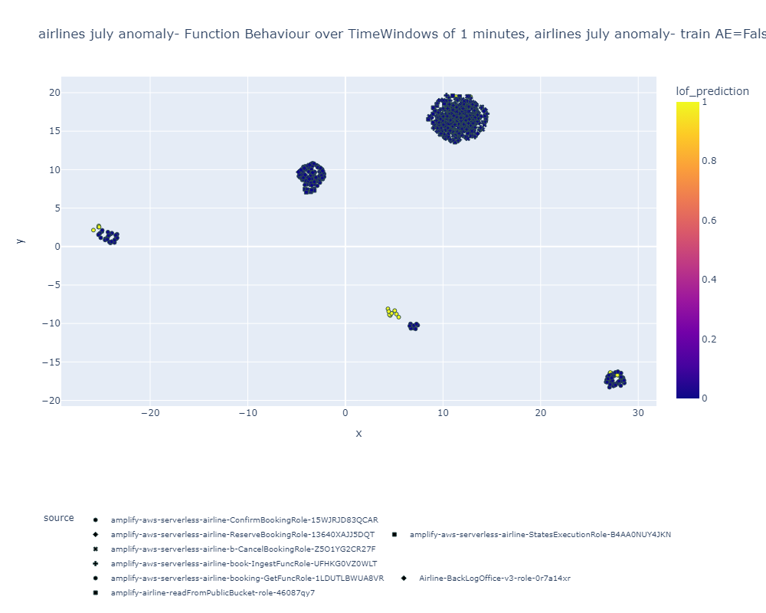
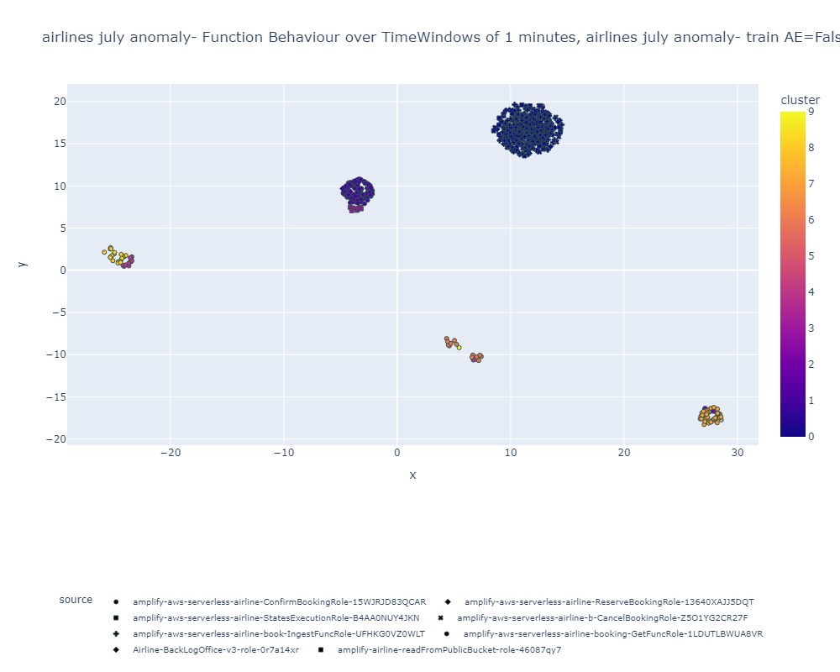
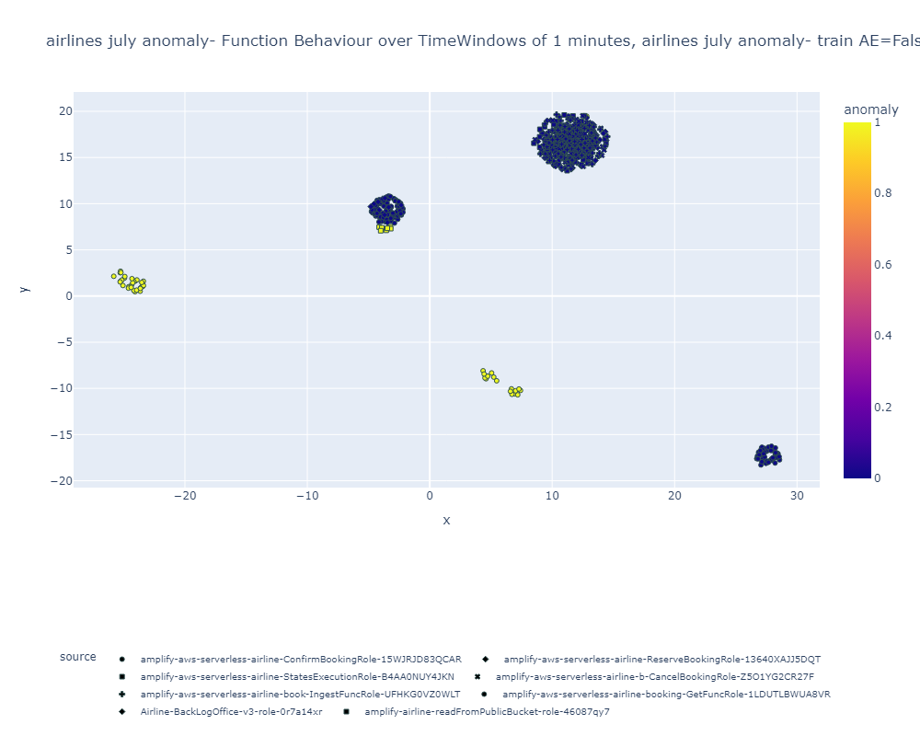
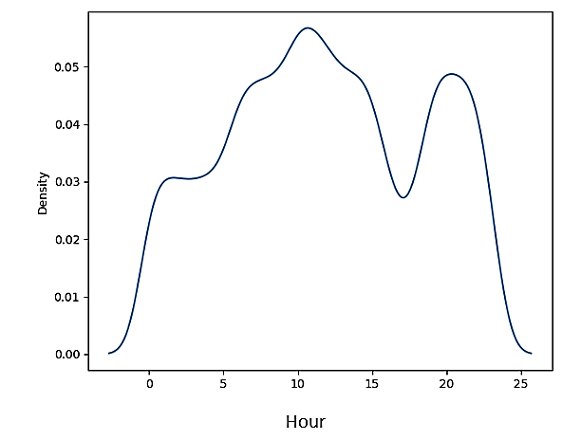
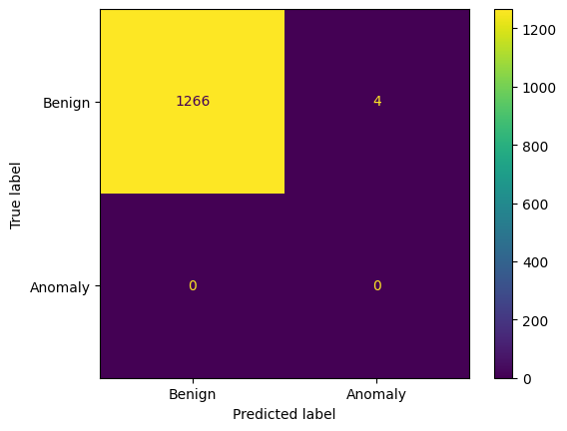
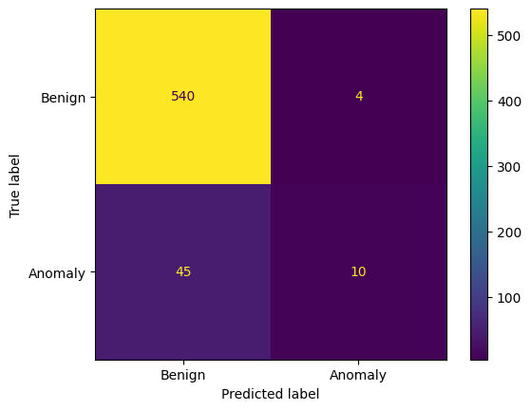
Evaluation and Results – Airline Dataset
Experiment:
8 Functions (1 dormant anomaly)
User simulation driven
9 clusters (KMeans)
Overlapping function behaviors
(n_neighbors=20, contamination=0.145)
Ground truth (Anomaly, Confirm Booking Func.)
Prediction (LOF based)
Notes:
The management and security of such applications are complicated due to many functions and resources, a lack of visibility and context, and the fact that the analysts are unfamiliar with the application structure.
Analyzing and handling security incidents becomes very complicated and time-consuming.
The inability to understand the application logic from the point of view of an operator who is not aware of the application design due to the complex interaction among many serverless elements as well as the rapid code changes to serverless applications which are difficult to track from the documentation.

Slide 19
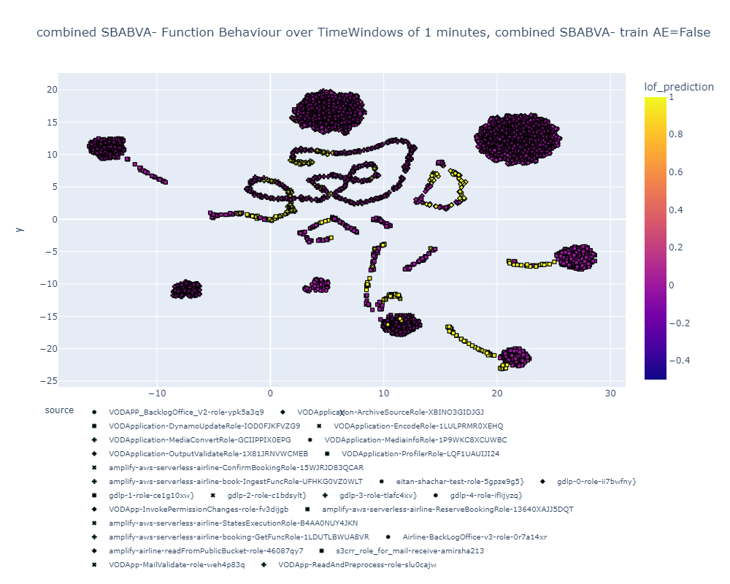
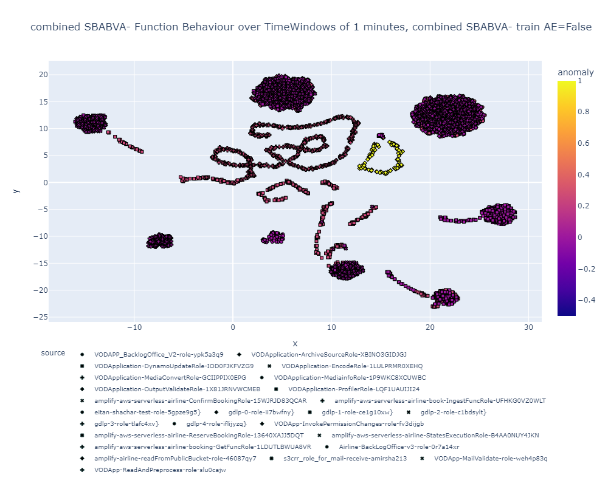
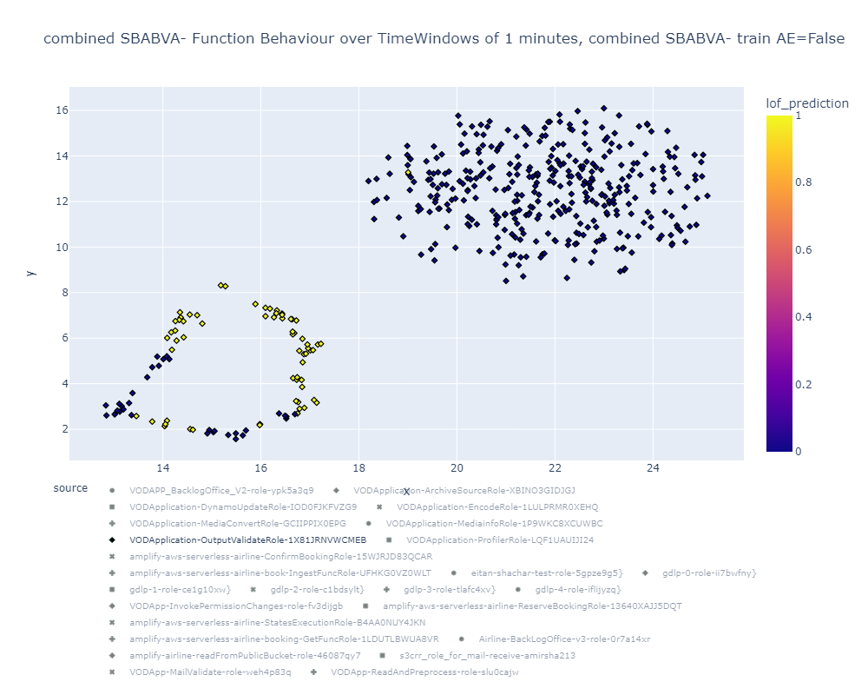
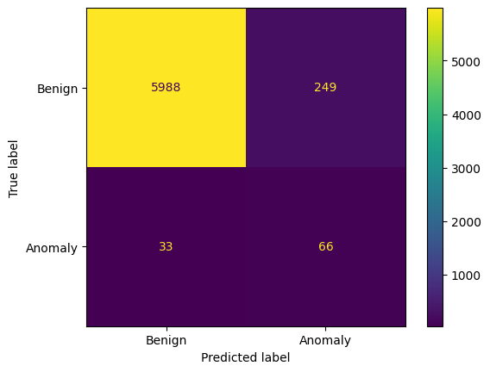
Evaluation and Results – Application Agnostic
Experiment:
2 Benign (Airline, Simple & VoD)
1 Benign & Anomalous (VoD)
26 Functions (1 anomalous)
Timer & User simulator. driven
30 clusters (KMeans)
Ground truth displayed (Output Validate Func.)
(n_neighbors=20, contamination=0.145)
LOF Prediction
Function Zoom-in, LOF was able to detect part of the anomalous behavior (lower left)
FPR 4%, TPR 66%
Notes:
The management and security of such applications are complicated due to many functions and resources, a lack of visibility and context, and the fact that the analysts are unfamiliar with the application structure.
Analyzing and handling security incidents becomes very complicated and time-consuming.
The inability to understand the application logic from the point of view of an operator who is not aware of the application design due to the complex interaction among many serverless elements as well as the rapid code changes to serverless applications which are difficult to track from the documentation.

Slide 20
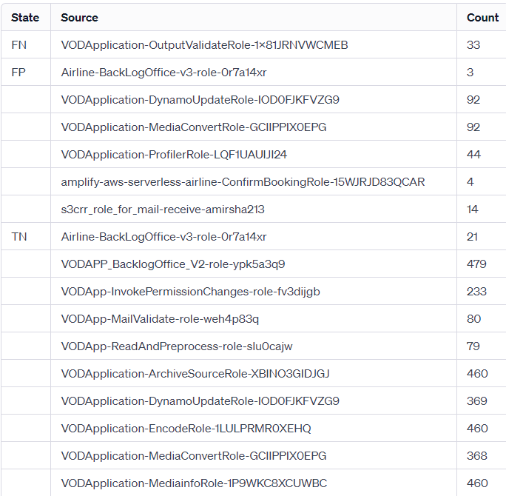
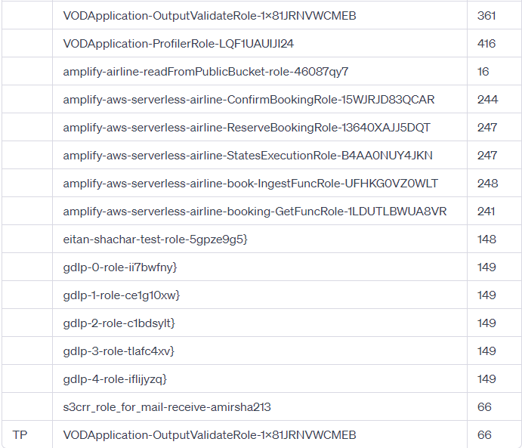
Evaluation and Results – Application Agnostic

Slide 21
Contribution & Insights
Generic Data Leakage Detection: This application-agnostic method identifies potential data leaks by analyzing behavioral shifts of Lambda functions’ public bucket access, pinpointing anomalies that could signify leakage or misconfigurations.
Complex Pattern Tracking: Capable of detecting subtle changes in write patterns, even among existing public buckets, to identify unusual activities suggesting malicious intent.
Context and Behavior-Focused Anomaly Detection – The method specializes in identifying deviations from normal patterns by deeply analyzing the context and behavior functions. This approach is particularly effective in today's landscape, where attackers can leverage LLMs to modify code, making it operate and appear normal while executing malicious activities.
Efficient Data Analysis: Minimal pre-training for the autoencoder and no training for the LOF algorithm.
Adaptability to New Challenges: The method is highly adaptable to new domains and challenges, requiring only some feature engineering to tailor it to specific problems.
In-Depth Insights Analysis Tool: This can be used as an advanced tool for log examination, enabling the detection of significant shifts in lambda function behavior. Practical application for security teams enables security teams to efficiently focus and explore top-ranked findings.
Notes:
The management and security of such applications are complicated due to many functions and resources, a lack of visibility and context, and the fact that the analysts are unfamiliar with the application structure.
Analyzing and handling security incidents becomes very complicated and time-consuming.
The inability to understand the application logic from the point of view of an operator who is not aware of the application design due to the complex interaction among many serverless elements as well as the rapid code changes to serverless applications which are difficult to track from the documentation.

